Slide 1
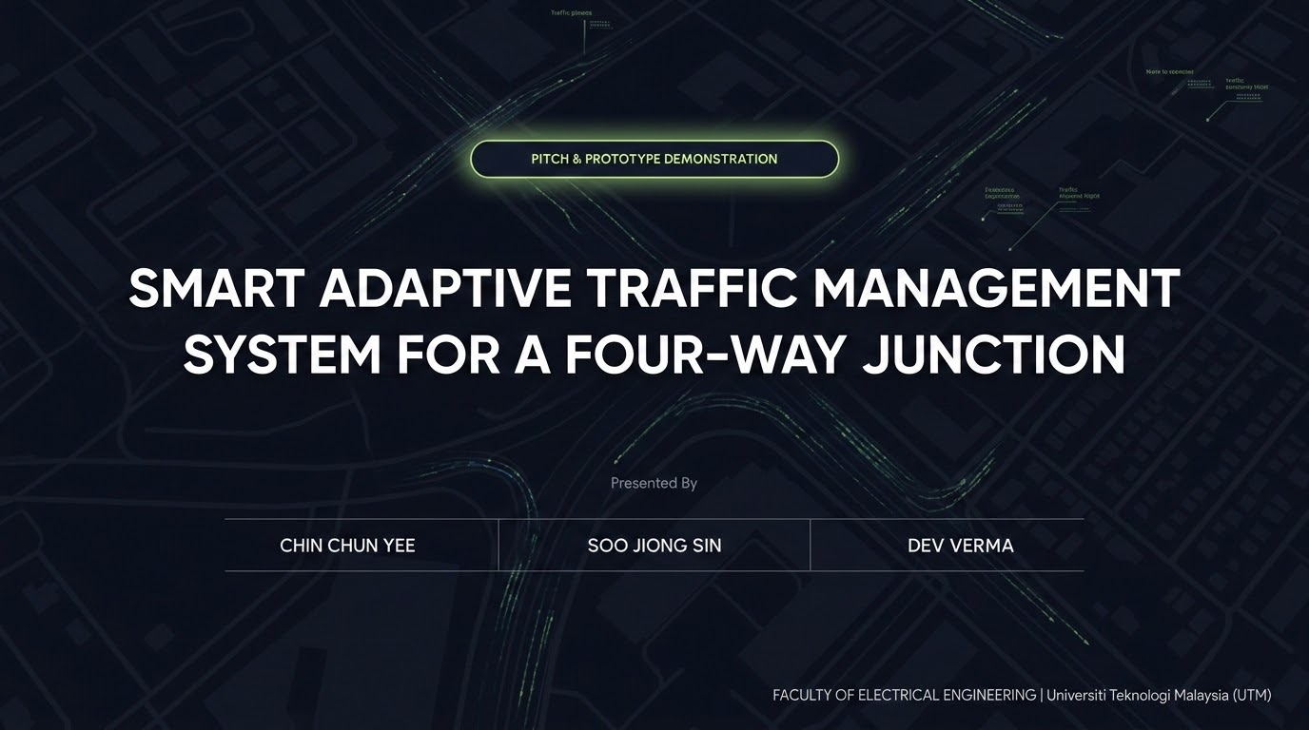

Slide 2

1. Problem Background
The Bottleneck: Conventional Intersections
report_problemLane Starvation: Empty roads receive green cycles while high-density lanes wait indefinitely.
trending_downEconomic Drain: Gridlocks waste billions of productive hours annually.
co2Environmental Impact: Excessive vehicle idling drastically increases carbon emissions.
trafficPedestrian Disruption: Immediate pedestrian button interrupts halt vehicle flow abruptly.
Adaptive Traffic Management
Modern traffic networks need responsive systems that automatically adjust to changing road conditions, ensuring vehicles keep moving efficiently and preventing unnecessary delays.
Scope of Project
Implementation of an STM32 Cortex-M4-based controller that utilizes real-time HC-SR04 ultrasonic sensor data to replace conventional, fixed-timer infrastructure.

Slide 3

2. Objective
timer
Dynamic Timing
Dynamically adjust green-light durations based on real-time vehicle density to optimize intersection throughput.
published_with_changes
Guaranteed Lane Access
Implement a bounded circular sequence with 2s, 5s, and 10s adaptive green durations to ensure balanced traffic flow.
directions_walk
Safe Access
Integrate seamless pedestrian push-button requests without causing excessive disruption to the established vehicle flow.

Slide 4
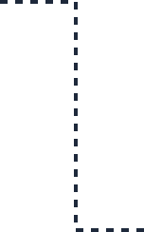
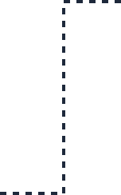
3. Proposed Solution
Adaptive Priority Control
An edge-computed traffic controller powered by an STM32 Cortex-M4. By analyzing spatial data from ultrasonics, it transitions from reactive to proactive traffic management.
check_circleReal-time density sensing via 8-point ultrasonic arrays.
check_circleHAL tick-based phase timing with DWT microsecond timing for ultrasonic echo measurement.
check_circleEXTI push-button interrupts for controlled pedestrian phases.
radar
Ultrasonic x8
HC-SR04 Density Input
memory
STM32 F446RE
Cortex-M4 Edge Core
GPIO • EXTI • DWT • HAL Tick
traffic
R/Y/G LEDs
Phase Execution
touch_app
Push Button
Pedestrian Request

Slide 5
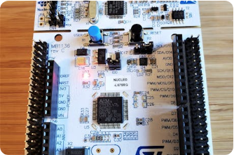
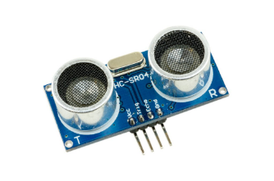
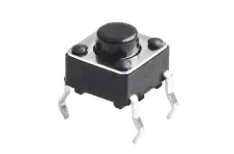
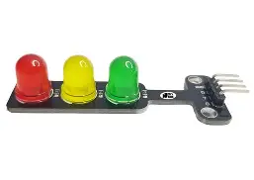
4. Materials Used
STM32 Nucleo-F446RE
32-bit Cortex-M4 MCU. Manages GPIO traffic LEDs, EXTI pedestrian interrupts, HAL tick timing, and DWT-based ultrasonic pulse measurement.
HC-SR04 Sensors (x8)
Dual sensors per direction estimate traffic occupancy as 0, 1, or 2 blocked sensors.
Push Button
Four active-HIGH tactile switches using EXTI interrupts and internal pulldown configuration.
LED Traffic Light
Four R/Y/G LED modules represent the junction signals. Each module is driven by STM32 GPIO outputs to display red, yellow, and green phases during adaptive traffic control.

Slide 6

5. Methodology
System architecture maps complex physical inputs to low-level microcontroller hardware resources for deterministic performance.
Sub-System
STM32 Hardware Resource
Logic Execution Strategy
Phase Control
HAL tick / HAL_Delay
Red, green, and yellow phases controlled using millisecond delays
Density Check
DWT Cycle Counter
Microsecond ultrasonic echo timing
Sensor Filtering
Median-of-3 readings
Rejects single-shot spikes; 60 ms settle delay between near/far readings
Pedestrian Request
NVIC EXTI
Button press sets pending flag; handled at next safe red phase
Traffic Output
GPIO
Controls 12 red/yellow/green LED outputs

Slide 7




6. Algorithm Workflow
A circular sequence prioritizes lanes using real-time density triggers while ensuring non-starvation.
Heavy Traffic
Near & Far blocked • 10.0s Green
shield
Safety Buffers
3s Yellow + 2s All-Red
directions_walk
Pedestrian Request
EXTI stores the request. During the next safe red phase, the system performs 2s yellow blinking and 2s red blinking, then resumes the normal red gap before green.
No Traffic
Zero blocked • 2.0s Green
Low Traffic
1 blocked • 5.0s Green

Slide 8

7. Commercial Value Proposition
Disruptive smart junction optimization engineered for high-performance and low-cost deployment
settings_input_component
AdaptiveFlow
Low-Cost Smart Junction Controller
report_problem
The Problem
Traditional fixed timers operate on rigid schedules, wasting green light cycles on empty lanes while forcing heavy traffic to idle, driving up congestion and frustration.
memory
The Solution
Real-time ultrasonic sensors monitor lanes continuously. Our STM32 adaptive control algorithm dynamic recalculates green phase durations dynamically to maximize flow.
trending_up
The Value
Ensures less waiting, fairer driver access, and safer pedestrian phases. All with a highly cost-efficient localized deployment model.
“AdaptiveFlow delivers smart-junction behavior without expensive cameras or cloud dependencies.”

Slide 9





9. LIVE DEMO
Witness the Prototype in Action
Observing Density Triggers (2s / 5s / 10s logic)
Testing Pedestrian Interrupt (EXTI) Request
Verifying Hardware Safety Buffers

Slide 10


10. The End
Questions?
Thank you for your time. We are ready to answer any questions regarding the technical design or commercial viability.
FACULTY OF ELECTRICAL ENGINEERING
Universiti Teknologi Malaysia (UTM)

